Slide 1
Whitemarket
By Group 1E

Slide 2
Overview
Introducing our web-based trading platform “White Market”, designed for professional traders and serious collectors. Our platform offers advanced functionality and a sleek, minimalistic design to stand out from competitors like eBay. Users can buy, sell, and bid on both tangible and digital collectibles, including figurines, memorabilia, digital items such as in-game skins, NFT’s and more.
We have tailored it for professional traders, or serious enthusiasts, and its functionality and design reflect that, with a sleek and minimal aesthetic and features that with draw these users over sites like eBay.
It offers the functionality to buy, sell, and bid on items, as well as track price changes over a period, provide news on any given store, and some security elements to mitigate bots and scammer via captcha and unique user ID’s.
Users can create accounts, customize their profiles and begin listing and buying items.
Our initial scope is focused on trading collectible cards, such as Pokémon and baseball cards. However, our platform is designed to host different storefronts for a wide range of collectibles, both tangible and digital.

Slide 3
User requirements
Users must be able to create and manage their account.
User must be able to sign in and out of their account.
Users should be able to create trades with photos and be able to manage the trade.
Users should be able to create a buy-able item with a photo instead of a trade.
Users should be able to create bids/offers on other trades.
Users should be able to sort and filter the storefront.
Users should be able to view owner history of that specific collectible, a graph of previous selling prices, and current offers for that trade.
Users should be able to accept trade offers.
Users should be able to rate the seller after purchase/trade.

Slide 4
User personas

Slide 5

The serious collector
Joseph is a baseball card enthusiast. He is 70 years old and has, for many years, collected the rarest baseball cards in circulation.
Aside from collecting cards, he also trades them.
For some time, he has been looking for an online platform that will allow him to trade and collect rare baseball cards with enthusiasts all over the world.
He wants a professional site that will offer analytics of seller trustworthiness so that he will be able to ensure he doesn’t get scammed or sold a card that is in a bad condition.

Slide 6

The professional trader
Daniel is a 29-year-old gamer who is addicted to League of Legends. Daniel and his friends have, for many years, sold digital collectibles ,such as CS:GO weapon skins.
Over the years, Daniel and his friends have collected a large stockpile of digital products and collectibles and wish to start a proper business in order to increase their profits.
Daniel is looking for a trading platform that will allow him to sell digital memorabilia and one that offers detailed analytics on things like product price history and stock, which will allow him to accurately calculate the most optimal price to sell his digital collectibles at.

Slide 7

The casual collector
Lukas is a 25-year-old Pokémon fan who loves to collect Pokémon cards.
He is looking for a reputable site that will allow him to buy Pokémon cards.
Since Lukas does not have a lot of disposable income, he wants to make sure that he buys the cards for the lowest price possible.
He is looking for a website that will allow him to see the price history for a product, which will allow him to determine if he is buying the card for the cheapest price possible.
He also wants to be able to see the condition of the card. Lukas is very easily tricked, so he wants a way to view seller trustworthiness.

Slide 8
Er diagram

Slide 9
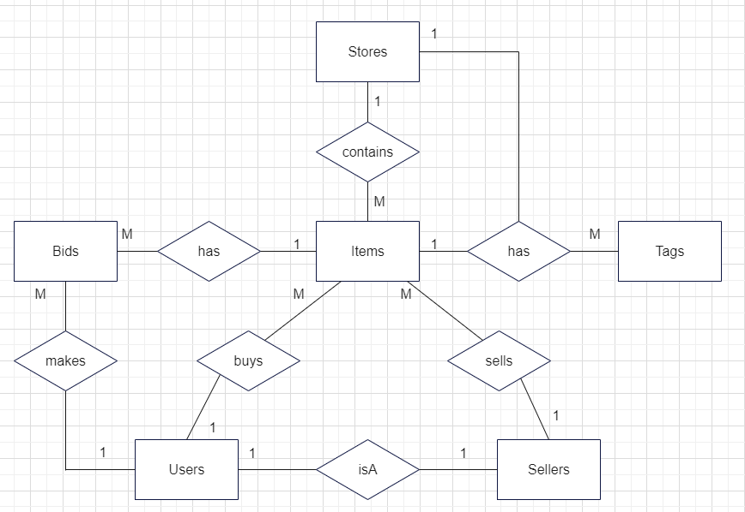
ER Diagram

Slide 10
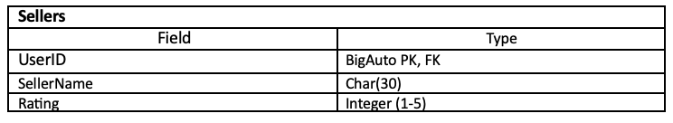
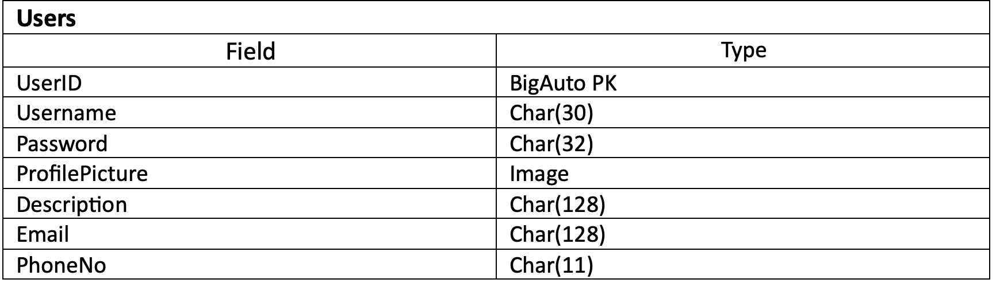
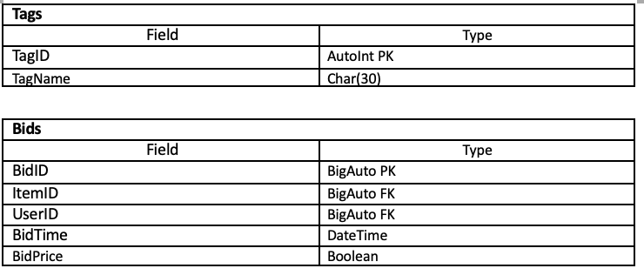
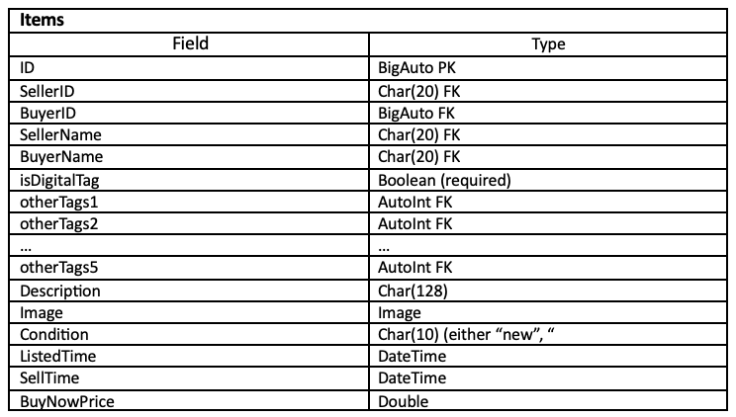
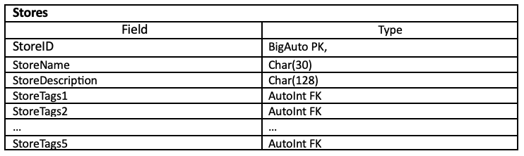
Attribute Tables

Slide 11
Walkthrough

Slide 12
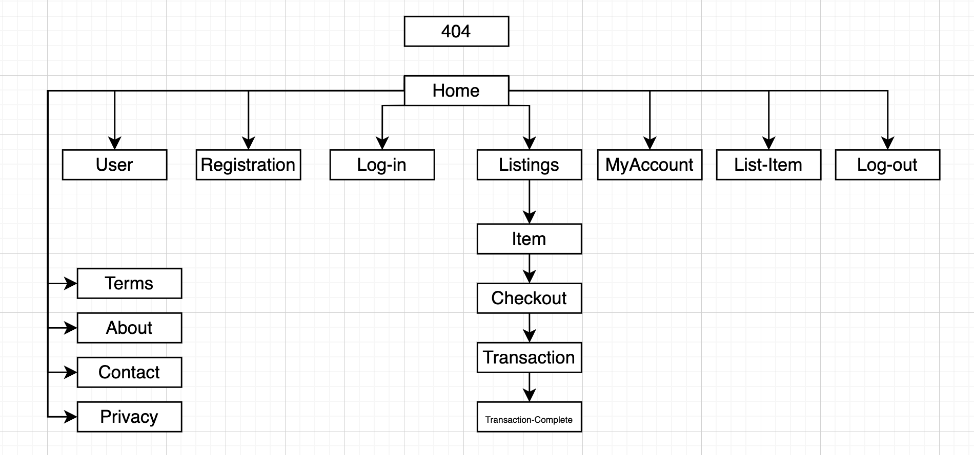
Site map

Slide 13
URLS
/home
/myaccount
/user/*username*
/registration
/log-in
/listings/*itemid*/checkout/transaction/transaction-complete
/list-item
/log-out
/terms
/contact
/about
/privacy

Slide 14
System architecture

Slide 15
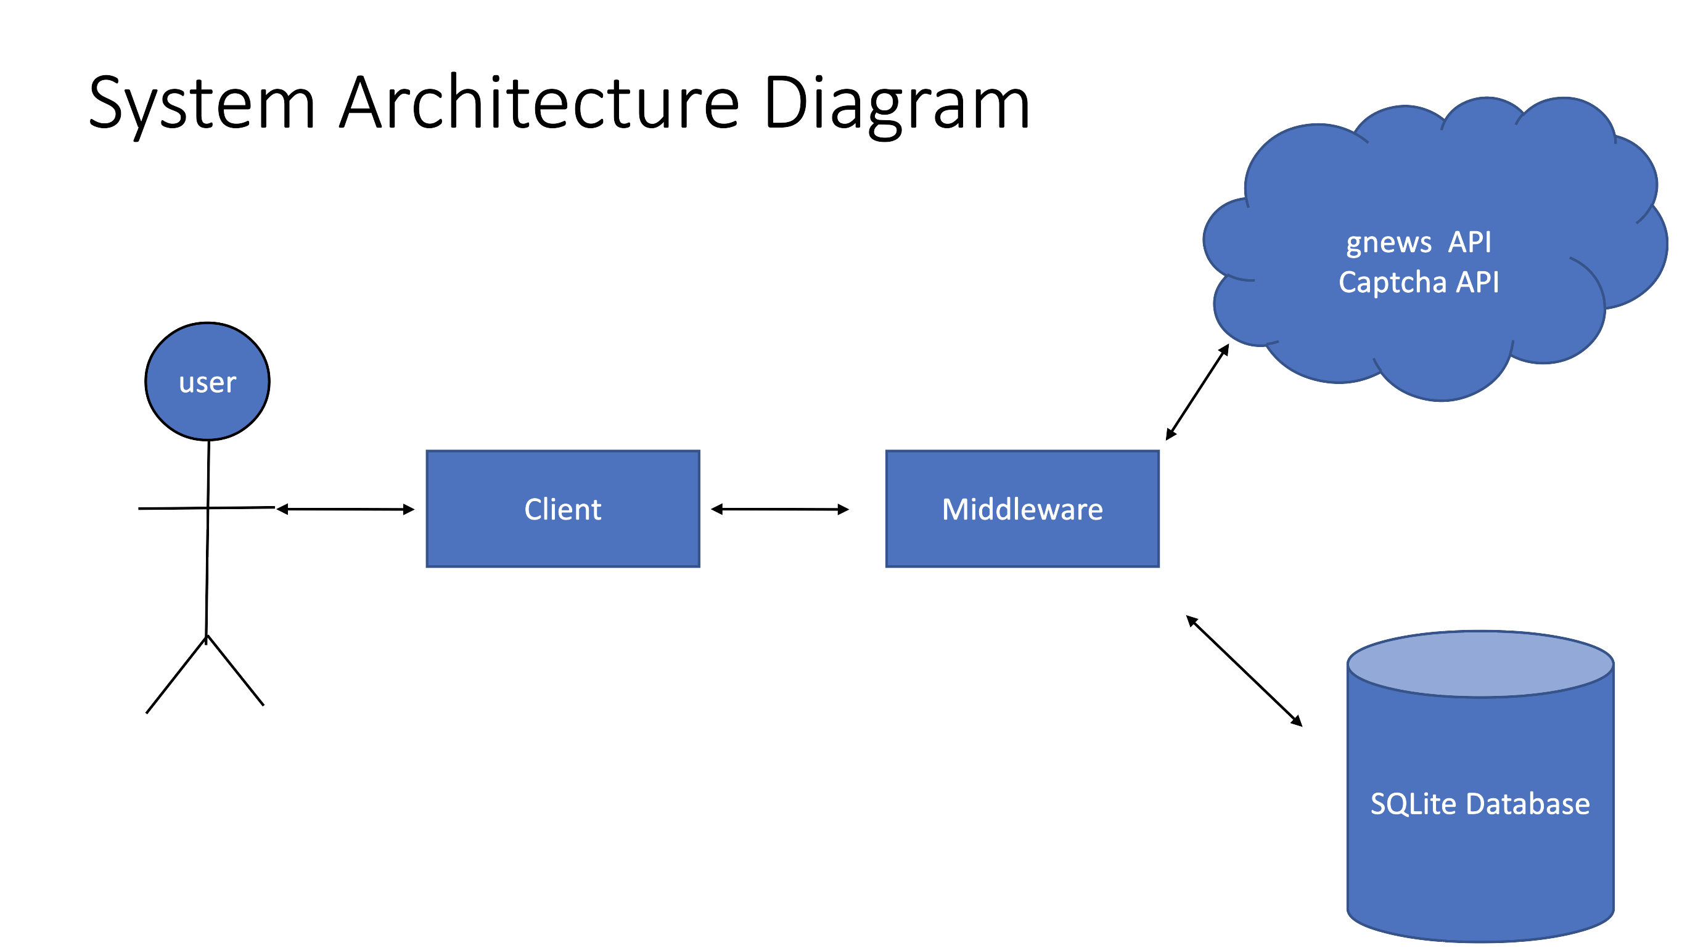
System architecture

Slide 16
Wireframes

Slide 17
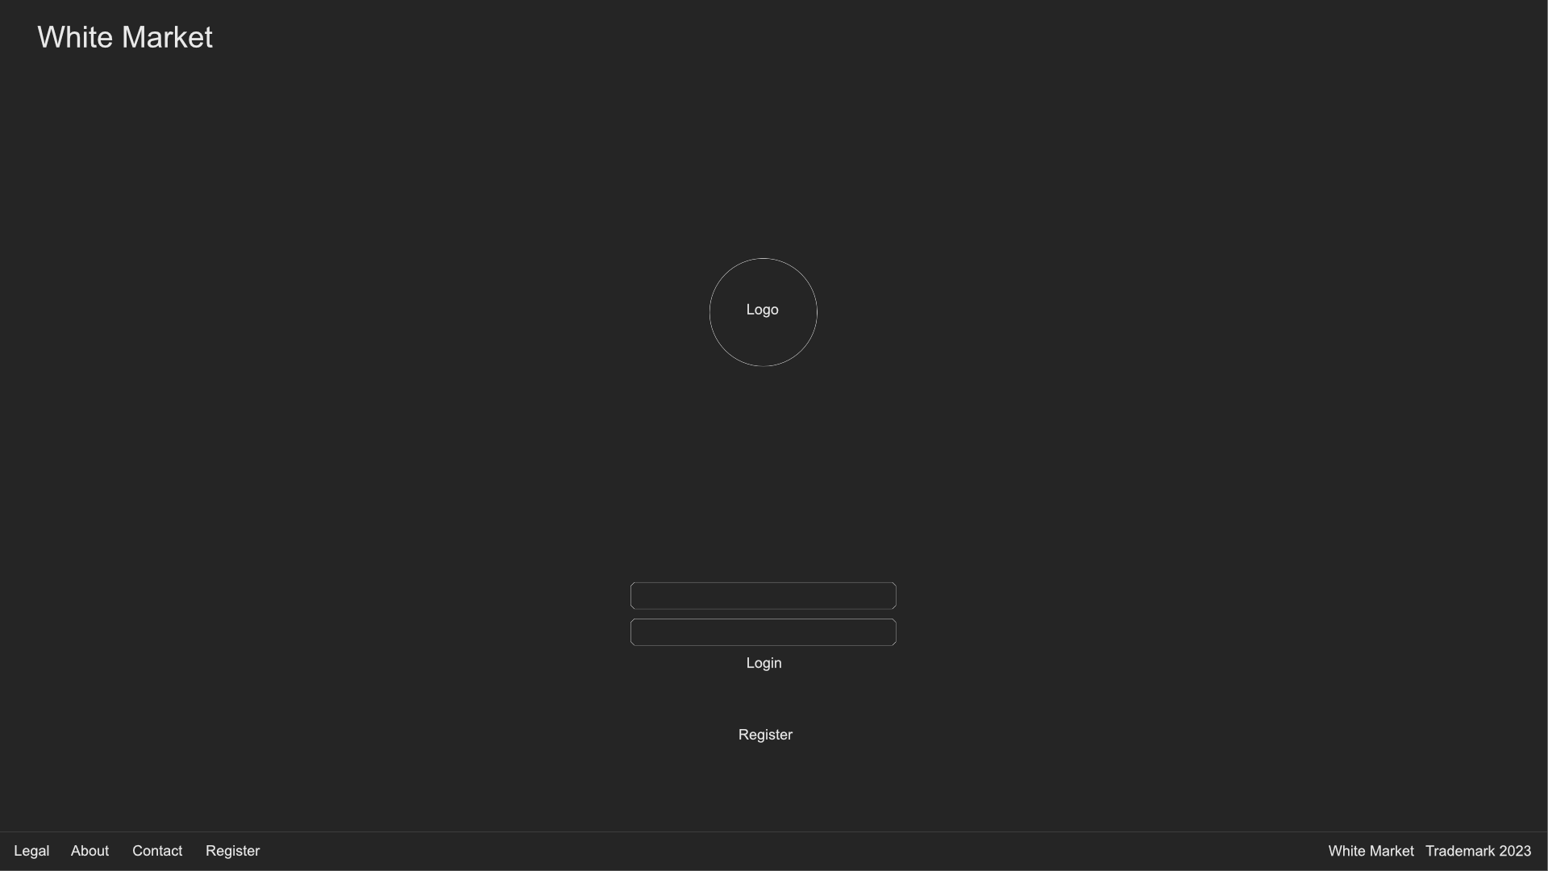
Login page

Slide 18
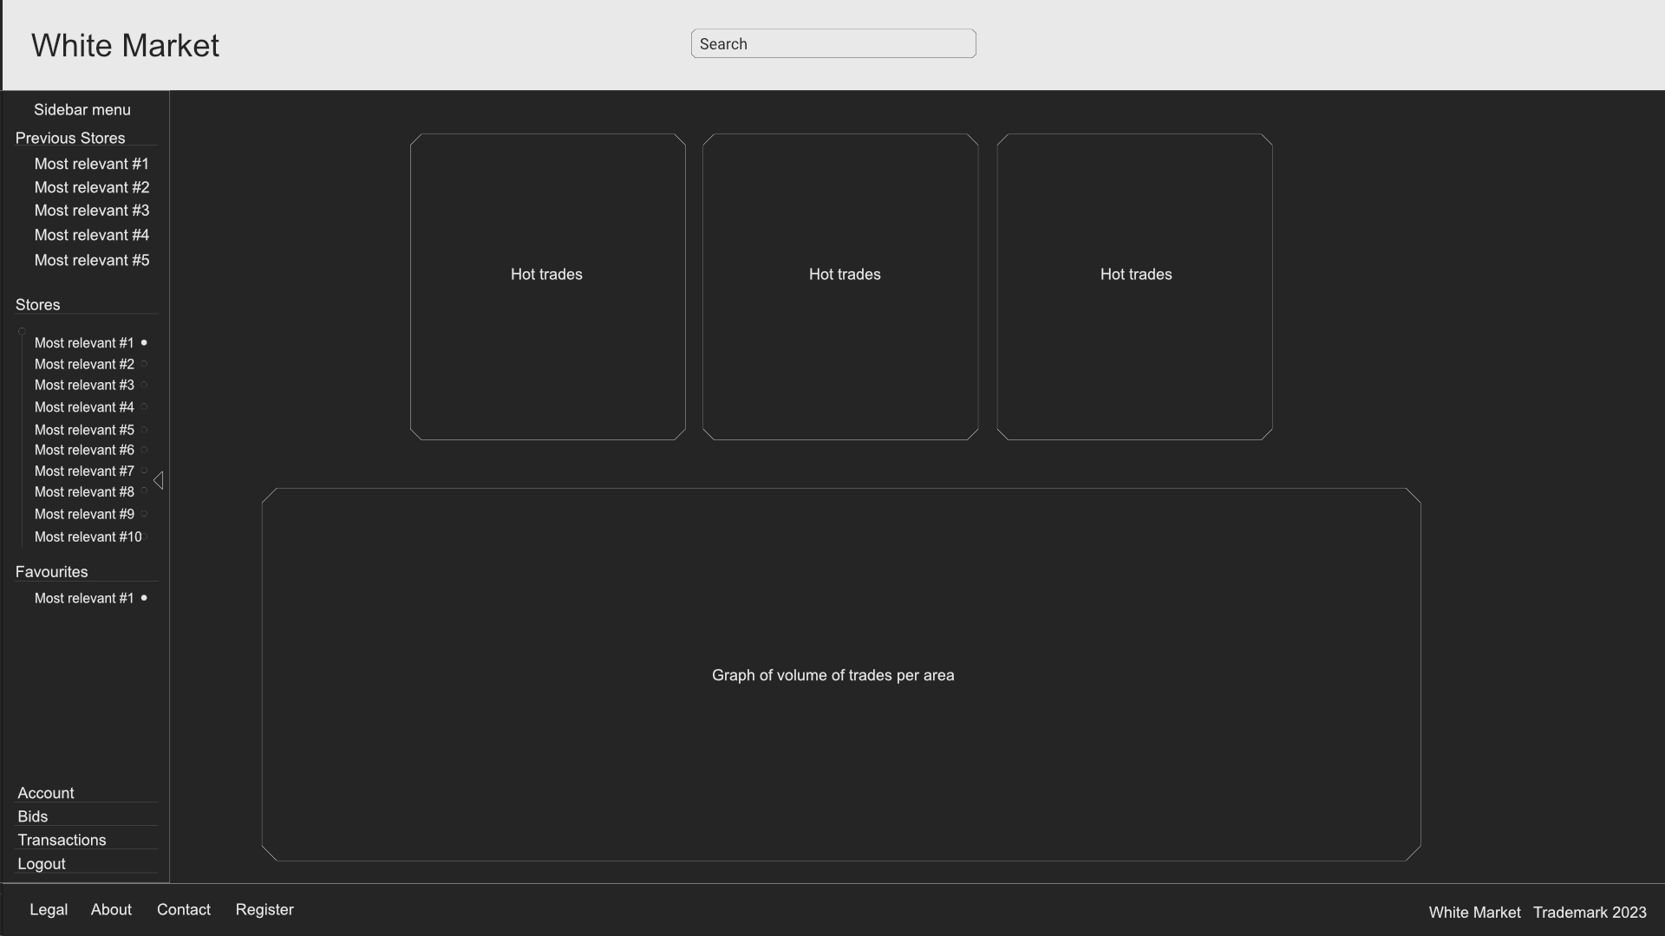
Home page

Slide 19
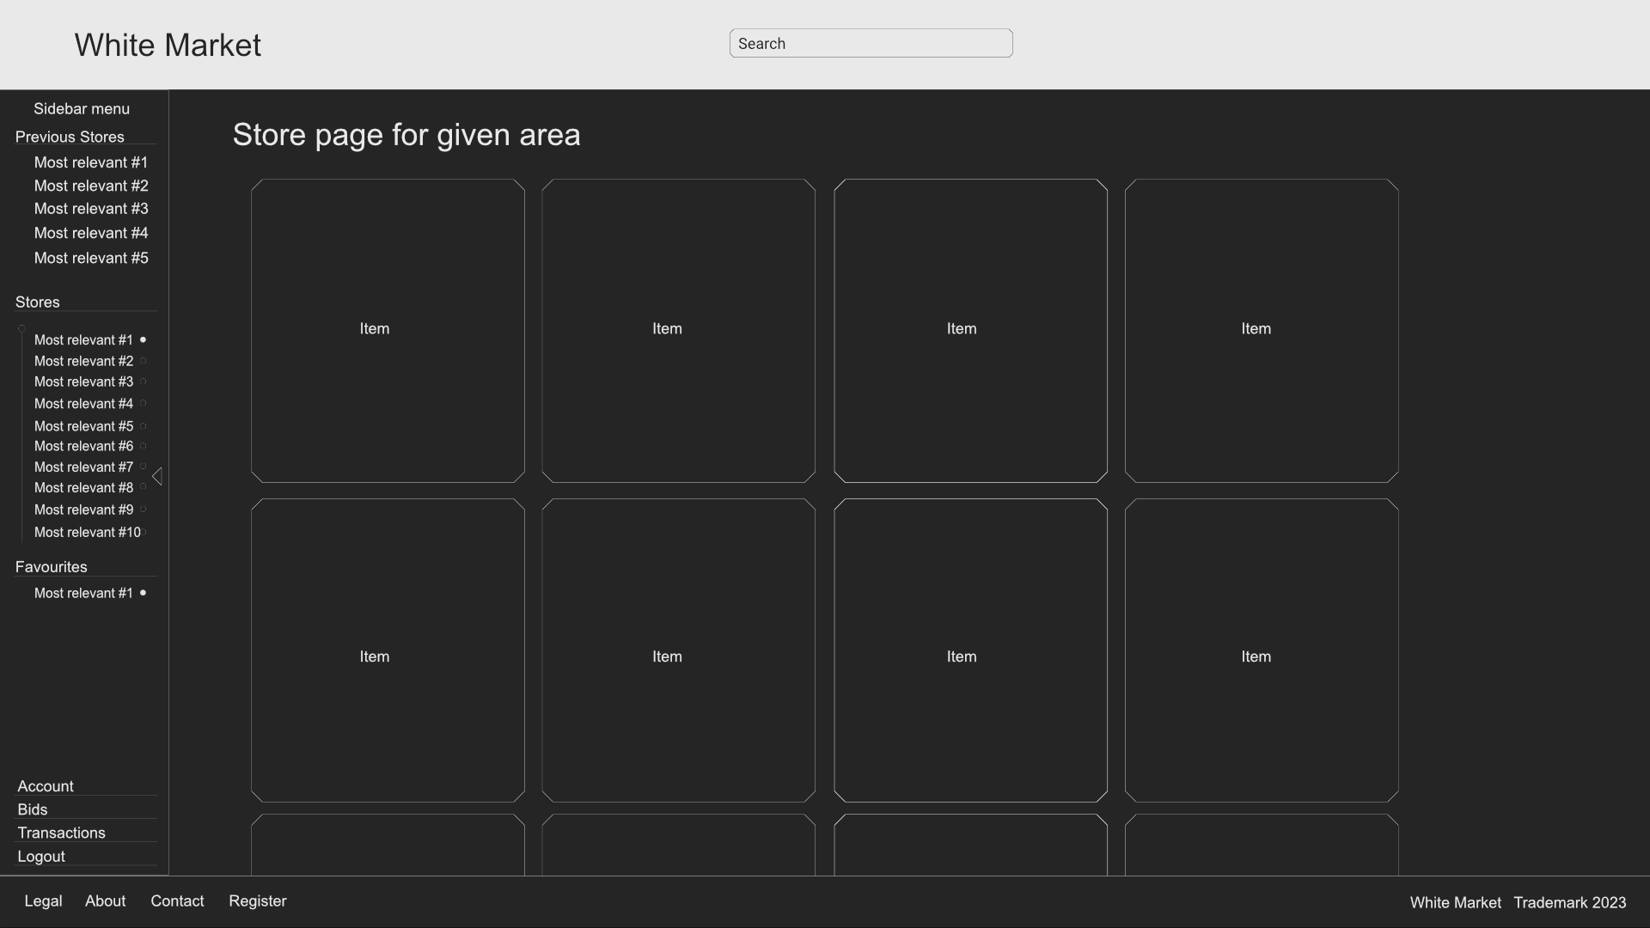
Store page

Slide 20
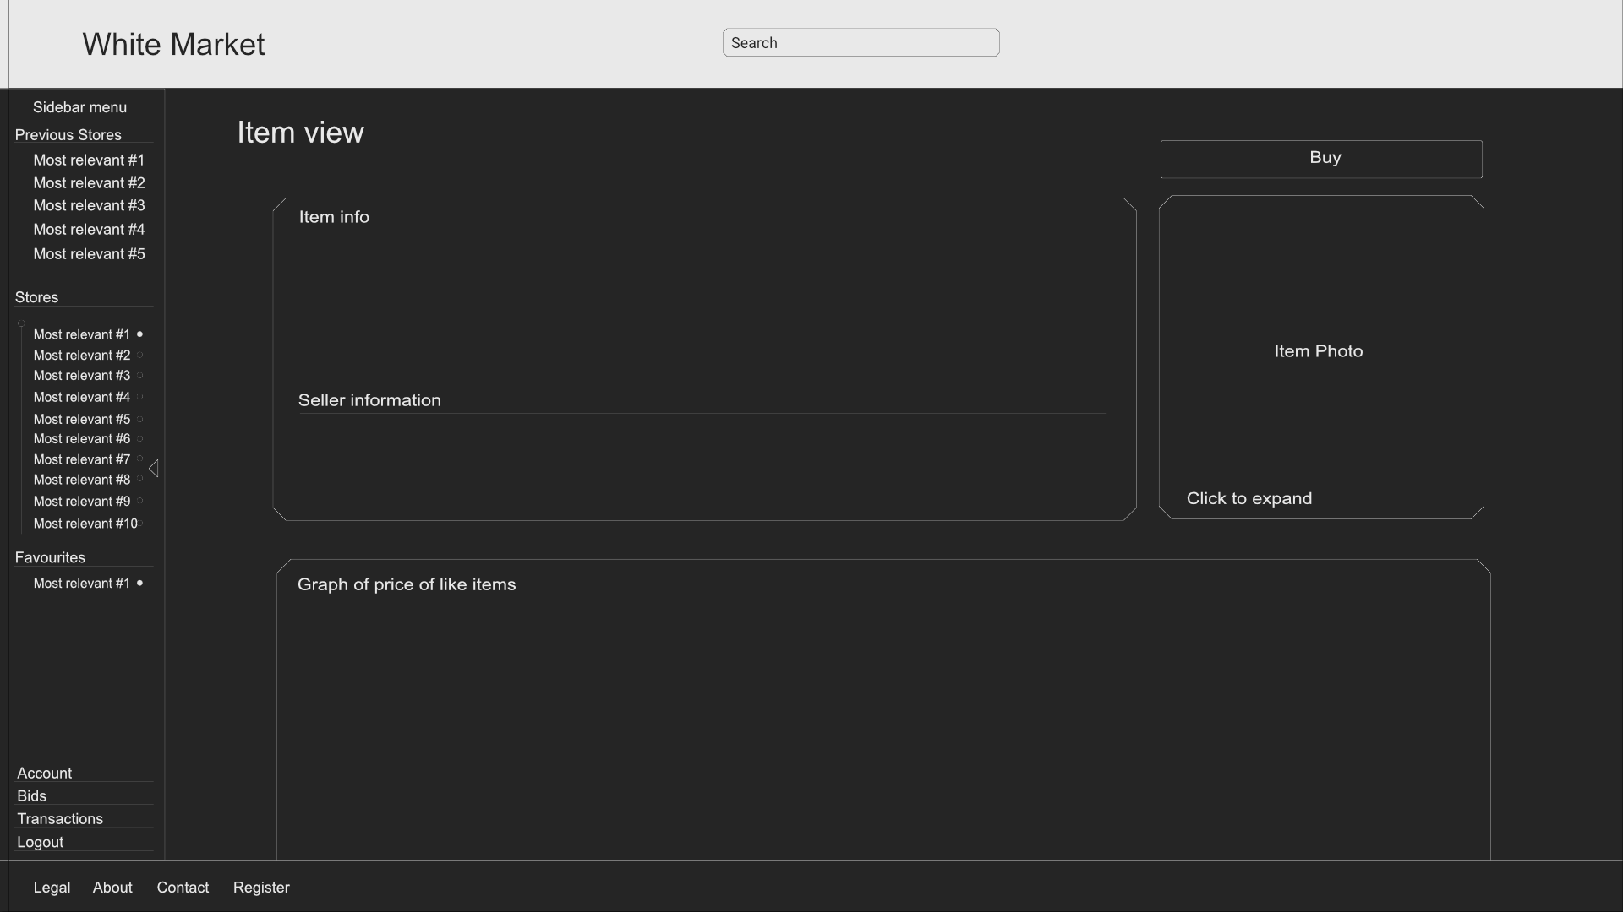
Buy-able item

Slide 21
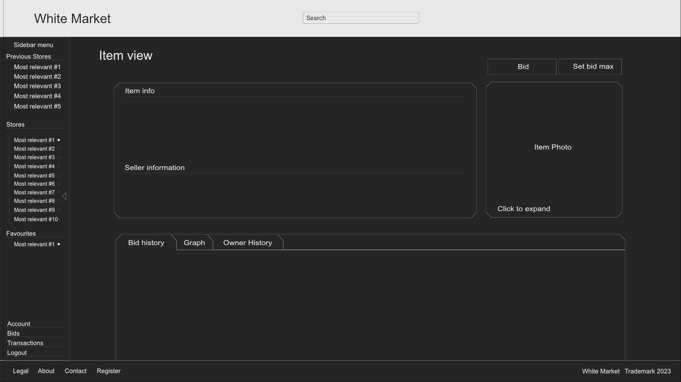
Bid-able item

Slide 22
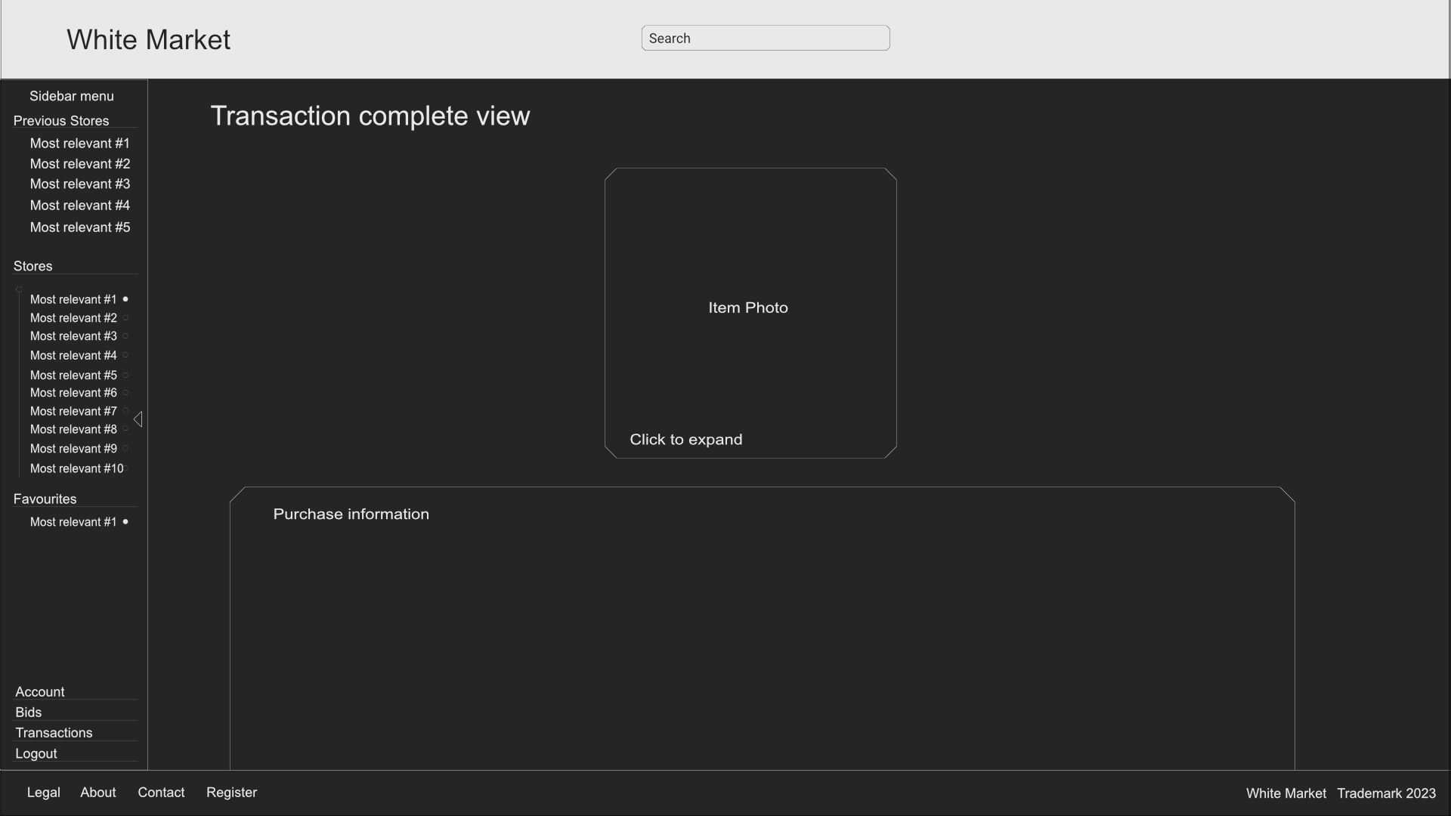
Transaction complete

